Slide 1

Stock Time Series Data Prediction Using Machine Learning Techniques
BATCH : B4
Project Members
19JG1A1210 – G.R.K.Sindhu 19JG1A1234 – P.L.Prasanna 19JG1A1229 – M.Amrutha
20JG5A1202 - A.Rishitha
Project Guide
Dr.Dwiti Krishna Bebarta
Associate professor
Department of Computer Science(AI&ML), GVPCEW
Department of Information Technology
GAYATRI VIDYA PARISHAD COLLEGE OF ENGINEERING FOR WOMEN
[Approved by AICTE NEW DELHI, Affiliated to JNTUK Kakinada]
[Accredited by National Board of Accreditation(NBA) for B.Tech. CSE, ECE & IT – valid from 2019-22 and 2022-25]
[Accredited by National Assessment and Accreditation Council (NAAC) with A Grade – valid from 2022-27]
Kommadi, Madhurawada, Visakhapatnam – 530048
Academic Batch : 2019 – 2023
1

Slide 2

PRESENTATION OUTLINE:
Abstract
Existing systems
Drawbacks of existing systems
Proposed systems
Advantages of proposed system
Hardware and software requirements
Data flow diagram
Dataset being used
List of modules
Implementation Results
Proposed system architecture
Future scope
References
Paper published
Stock Time Series Data Prediction using
Machine Learning Techniques Batch -no:04 2

Slide 3
ABSTRACT :
Stock market is a place where buying and selling of shares happen for publicly listed companies and stock exchange is the mediator that allows buying and selling of shares.Stock market prediction is a challenging task due to the highly noisy, complex and chaotic nature of the stock price data.The intra-day patterns are identified using the feature engineering schemes and several machine learning techniques.The deep learning methods are combined with latest machine learning models to predict the direction of the closing price.Accuracy plays an important role in stock market prediction. Although many algorithms are available for this purpose, selecting the most accurate one continues to be the fundamental task in getting the best results. In order to achieve this we are combining different models and creating a hybrid model which provides better accuracy.
Stock Time Series Data Prediction using
Machine Learning Techniques Batch -no:04 3

Slide 4
EXISTING SYSTEM :
Traditionally, two main approaches have been proposed for predicting the stock price of an organization. Technical analysis method uses historical price of stocks like closing and opening price etc.
The second type of analysis is qualitative, which is performed on the basis of external factors like company profile, market situation, political and economic factors,social media etc.
For example, Caginalp and Laurent performed a statistical test including eight kinds of three-day patterns and noted that the candlestick patterns have predictive power.
Machine learning techniques in this area have proved to improve efficiencies by 60-83 percent as compared to the past methods.
Stock Time Series Data Prediction using
Machine Learning Techniques Batch -no:04 4

Slide 5
DRAWBACKS OF EXISTING SYSTEM
However accuracy would decrease when setting more levels of stock market movement.
The average of prediction accuracies using Decision Tree as the classifier are 43.44%, 31.92%, and 12.06% for “two levels,” “three levels,” and “five levels,” respectively.
These results indicate that the stock price is unpredictable when traditional classifier is used.
Time series data are difficult to manipulate and predict.
Stock Time Series Data Prediction using
Machine Learning Techniques Batch -no:04 5

Slide 6
PROPOSED SYSTEM :
Accuracy plays an important role in stock market prediction. Although many algorithms are available for this purpose, selecting the most accurate one continues to be the fundamental task in getting the best results.
In order to achieve this, we have compared and analysed the performance of various available algorithms such as LSTM(Long-Short Term Memory), SVM(Support Vector Machine) ,GRU(Gated Recurrent Unit)etc.
This involves training the algorithms, executing them, getting the results, comparing various performance parameters of these algorithms and finally obtaining the most accurate one.
Stock Time Series Data Prediction using
Machine Learning Techniques Batch -no:04 6

Slide 7
ADVANTAGES OF PROPOSED SYSTEM
The successful prediction will maximize the benefit of the customer.
The time series data issue can be solved by focusing on segments instead of each data point, interesting patterns can be discovered and it becomes an easy task to query, understand and mine them.
We used stock data of five companies from the Huge Stock market dataset consisting of data ranging from 2017 to 2022 to train different machine learning algorithms.
Hence we compared the accuracy of different machine learning algorithms and showed the best prediction of closing stock.
Stock Time Series Data Prediction using
Machine Learning Techniques Batch -no:04 7

Slide 8
HARDWARE AND SOFTWARE REQUIREMENTS:
Hardware Requirements:
RAM – 8GB
i3 processor, 7th Gen
Software Requirements
Python 3.7
Windows 8 or 10 operating system
ML Libraries
Stock Time Series Data Prediction using
Machine Learning Techniques Batch -no:04 8

Slide 9
DATA FLOW DIAGRAM
Optimized learning pattern model
Stock market sale on closing price
Data Preprocessing
Normalized Model
Training set
Testing Set
Machine learning Model
(Target model)
Data Analysis
Buy/Sell point
Stock Time Series Data Prediction using
Machine Learning Techniques Batch -no:04 9

Slide 10
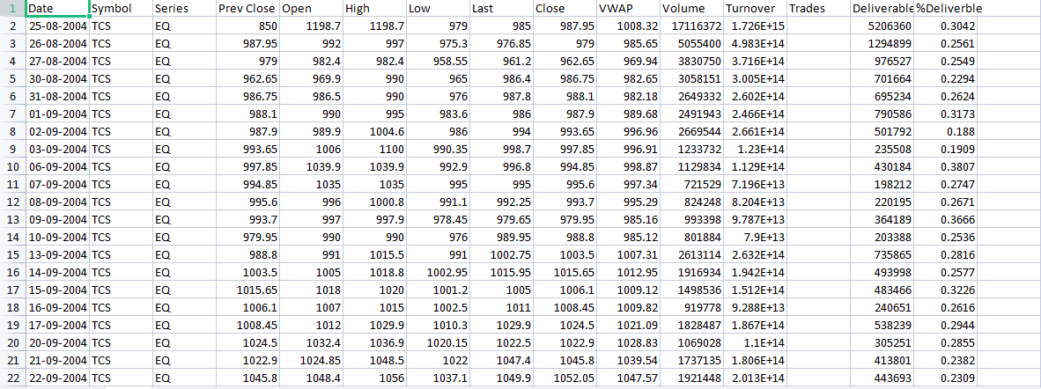
DATASET IS BEING USED :
Stock Time Series Data Prediction using
Machine Learning Techniques Batch -no:04 10

Slide 11
LIST OF MODULES
Module 1: Data Pre-Processing
Module 2: Training and testing the data with LSTM(Long Short Term Memory) model
Module 3: Training and testing the data with SVM(Support Vector Machine) model
Module 4: Creating a hybrid model with LSTM and GRU(Gated Recurrent Unit)
models.
Module 5: Performance analysis.
Stock Time Series Data Prediction using
Machine Learning Techniques Batch -no:04 11

Slide 12
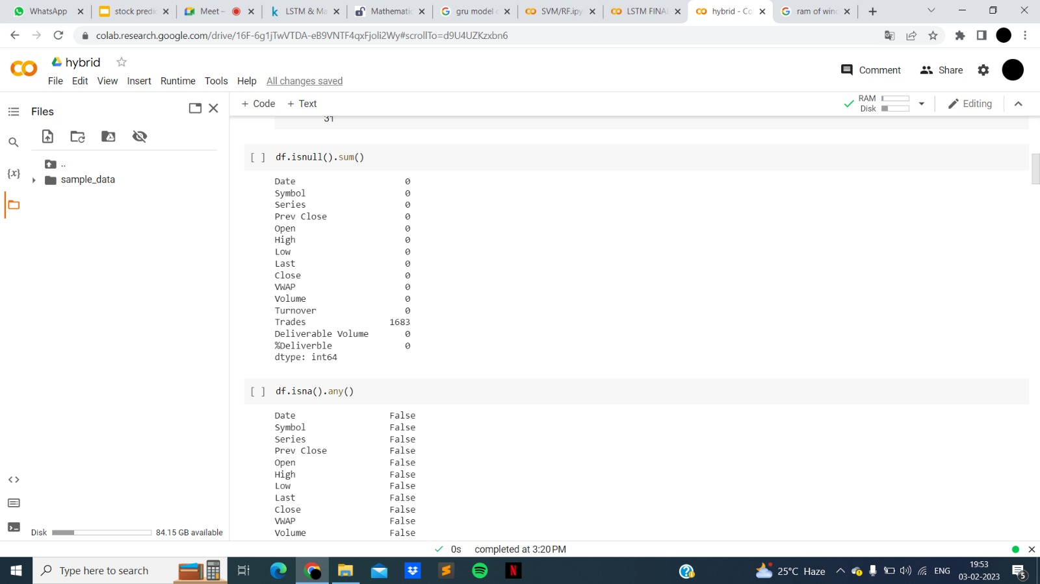
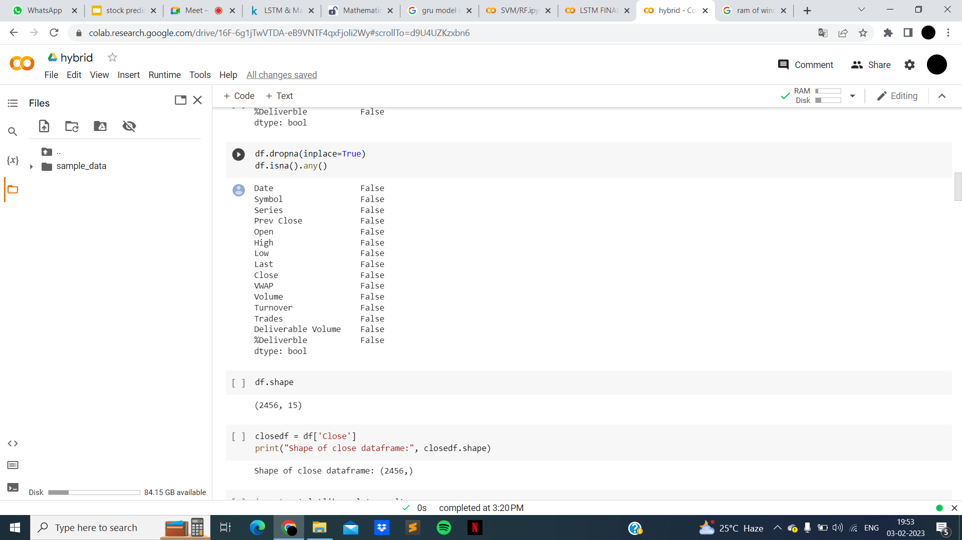
IMPLEMENTATION RESULTS
Module 1(Data preprocessing):
Stock Time Series Data Prediction using
Machine Learning Techniques Batch -no:04 12

Slide 13
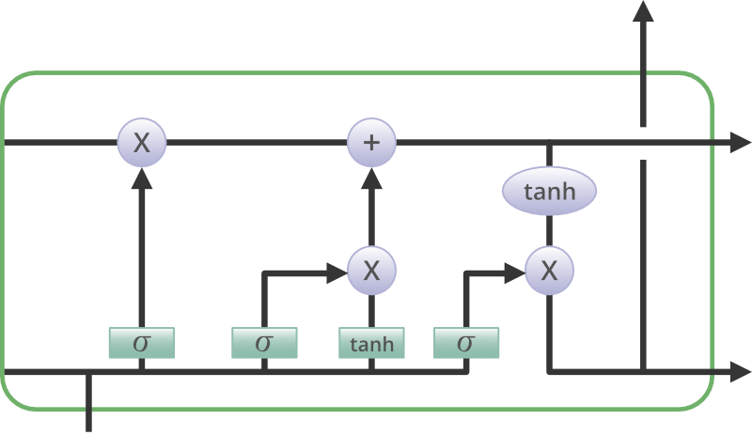
LSTM (Long-Short Term Memory)
Long Short-Term Memory (LSTM) is a type of Recurrent Neural Network (RNN) that is specifically designed to handle sequential data, such as time series, speech, and text.
LSTM networks are capable of learning long-term dependencies in sequential data, which makes them well suited for tasks such as language translation, speech recognition, and time series forecasting.
LSTM has a chain structure that contains four neural networks and different memory blocks called cells.
Three gates mainly:
Forget gate
Input gate
Output gate
Stock Time Series Data Prediction using
Machine Learning Techniques Batch -no:04 13

Slide 14
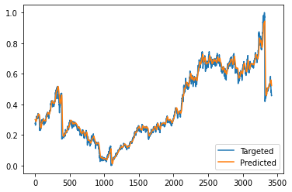
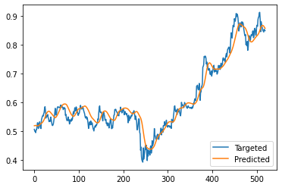
Module 2(LSTM MODEL):
Target and predicted of training: Target and predicted of testing:
Stock Time Series Data Prediction using
Machine Learning Techniques Batch -no:04 14

Slide 15
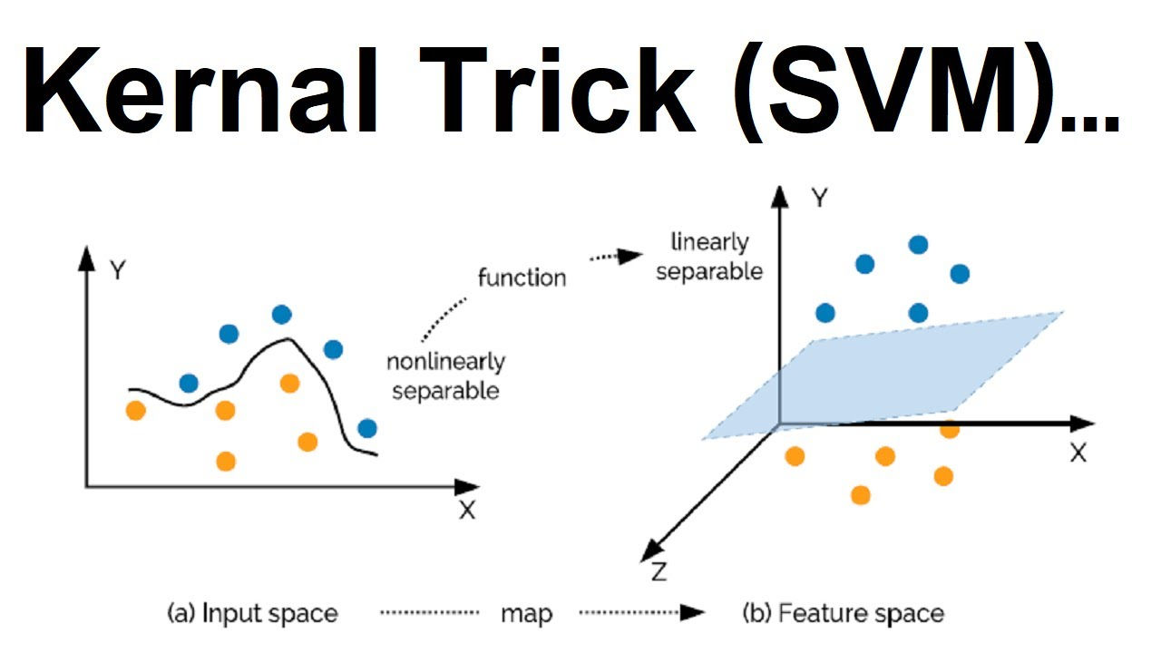
SVM (Support Vector Machine)
SVM algorithm is to create the best line or decision boundary that can segregate n-dimensional space into classes so that we can easily put the new data point in the correct category in the future. This best decision boundary is called a hyperplane.
SVM chooses the extreme points/vectors that help in creating the hyperplane.
These extreme cases are called as support vectors, and hence algorithm is termed as Support Vector Machine.
Stock Time Series Data Prediction using
Machine Learning Techniques Batch -no:04 15

Slide 16
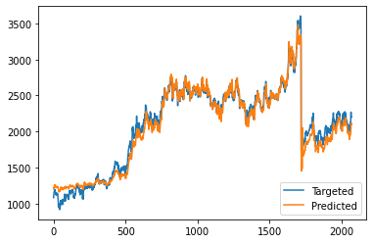
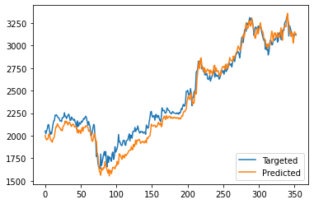
Module 3(SVM MODEL):
Target and predicted of training: Target and predicted of testing:
Stock Time Series Data Prediction using
Machine Learning Techniques Batch -no:04 16

Slide 17
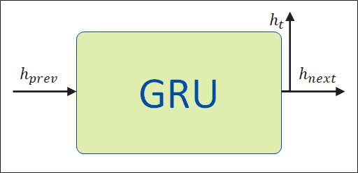
GRU (Gated Recurrent Unit)
Gated recurrent units (GRUs) are a gating mechanism in recurrent neural networks, introduced in 2014.
The GRU operates using a reset gate and an update gate. The reset gate sits between the previous activation and the next candidate activation to forget previous state, and the update gate decides how much of the candidate activation to use in updating the cell state.
GRUs have been shown to exhibit better performance on smaller datasets.
Stock Time Series Data Prediction using
Machine Learning Techniques Batch -no:04 17

Slide 18
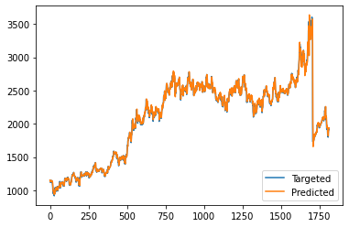
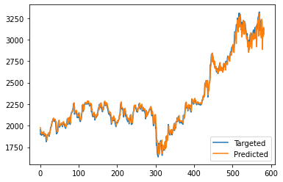
Module 4 HYBRID MODEL(LSTM & GRU):
Target and predicted of training: Target and predicted of testing:
Stock Time Series Data Prediction using
Machine Learning Techniques Batch -no:04 18

Slide 19
Proposed System Architecture
Stock data as input
Data preprocessing
Feature Selection
Training set
Testing Set
Create hybrid model
Train the model
Test the model
Evaluate Predictions Accuracy
Adjust parameters
Stock Time Series Data Prediction using
Machine Learning Techniques Batch -no:04 19

Slide 20
FUTURE SCOPE
The Module that can be enhanced for future development:
We want to add more stocks or enlisted companies for the investors to select or invest in future. So we wanted to create another vision for the investors to select multiple companies or datasets.
Stock Time Series Data Prediction using
Machine Learning Techniques Batch -no:04 20

Slide 21
REFERENCES
[1] D Brownstone, “Using the percentage accuracy to measure neural network predictions in stock market movements”, Neurocomputing, vol. 10, pp. 237-250, 1996.
[2] A. S. Chen, M. T. Leung, and H. Daouk, “Application of Neural Networks to an emerging financial market: Forecasting and trading the Taiwan Stock Index”, Comput. Operations Res., Vol-30, pp. 901-923, 2003.
[3] J. C. Patra, G Panda, R Baliarsingh, “Artificial neural network based nonlinearity estimation of pressure sensors”, IEEE transactions on instrument and measurement, vol 43, no 6, pp.874-881, Dec.1994.
[4] Pei-Chann Chang, Chin-Yuan Fan, “A Hybrid System Integrating a Wavelet and TSK Fuzzy Rules for Stock Price Forecasting”, IEEE transactions on Systems, MAN, and Cybernetics-Part-C: Applications and Reviews, Vol. 38, No. 6, Nov-2008
[5] Hua-Ning Hao, “Short-term Forecasting of Stock Price Based on Genetic-Neural Network”, 2010 Sixth International Conference on Natural Computation (ICNC 2010), IEEE Conference Publications.
[6] Y-H. Pao, “Adaptive Pattern Recognition & Neural Networks”, Reading, MA;Addison-Wesley, 1989.
Stock Time Series Data Prediction using
Machine Learning Techniques Batch -no:04 21

Slide 22
REFERENCES
[7] Y.H.Pao and Y.Takefji, "Functional-Link Net Computing", IEEE Computer Journal, pp.76-79, 1992.
[8]Hua-Ning Hao, “Short-term Forecasting of Stock Price Based on Genetic-Neural Network”, 2010 Sixth International Conference on Natural Computation (ICNC 2010), IEEE Conference Publications.
[9]S. K. Nanda1, Debi P. Tripathy, S.S. Mahapatra, “Application of Legendre Neural Network for Air Quality Prediction”, The 5th PSUUNS International Conference on Engineering and Technology (ICET2011), Phuket, May 2-3, 2011
[10]D Brownstone, “Using the percentage accuracy to measure neural network predictions in stock market movements”, Neurocomputing, vol. 10, pp. 237-250, 1996.
[11]Hua-Ning Hao, “Short-term Forecasting of Stock Price Based on Genetic-Neural Network”, 2010 Sixth International Conference on Natural Computation (ICNC 2010), IEEE Conference Publications.
Stock Time Series Data Prediction using
Machine Learning Techniques Batch -no:04 22

Slide 23

PAPER PUBLISHED
Stock Time Series Prediction Using Machine Learning Techniques
Mr. Dr. Dwiti Krishna Bebarta , Ganti Sindhu, Prasanna Penumatsa , Amrutha Mavuri ,Rishitha Alla ,
Information Technology, GVP College of Engineering for women, Vizag, India
https://doi.org/10.22214/ijraset.2023.50643
Stock Time Series Data Prediction using
Machine Learning Techniques Batch -no:04 23

Slide 24
Thank You
Stock Time Series Data Prediction using
Machine Learning Techniques Batch -no:04 24

